Slide 1
ML-Powered Shortlisting & Interview Aid
Intelligent Hiring Automation Using NLP and Machine Learning
Group 3:-
Devarsh Patel
Dharmitkumar Patel
Lovely Priya
Mansi Tanna
Swetha Madapati Shatayu Thakur
Smit Ardeshana

Slide 2
Motivation
Contextual Challenge in Recruitment
Recruiters receive hundreds of resumes for a single job opening.
Manual screening is time-consuming, inconsistent, and error-prone.
Often leads to qualified candidates being overlooked due to lack of standardization.
Modern Hiring Needs AI
Growing demand for automated, intelligent tools in HR tech.
Generic interview questions do not assess candidates’ real relevance to the role.
Real-World Impact
Companies spend up to 23 hours screening resumes per hire (LinkedIn research).
A poor screening process affects diversity, efficiency, and quality of hires.

Slide 3
Goal
Automatically evaluates and ranks resumes based on job fit.
Predicts shortlisting decisions using ML classifiers.
Generates personalized interview questions based on the resume and job description.
Provides transparent explainability of why a resume was shortlisted or rejected.

Slide 4
Problem Statement
The Core Problem
Recruiters face difficulty in efficiently identifying the right candidates from a large pool of resumes due to:
Lack of standardization in resumes (formats, structures, wording).
Manual filtering being subjective, inconsistent, and time-consuming.
Irrelevant interview questions that fail to evaluate candidate-job fit effectively.
What We Aim to Solve
Automate resume screening using semantic matching and machine learning.
Build a binary classification model to predict if a candidate should be shortlisted.
Generate context-aware, role-specific interview questions using advanced NLP techniques.
Add explainability using SHAP to build trust in ML-driven shortlisting.

Slide 5
Relevance in Industry & Academia
70% of hiring managers use AI for resume screening.
Ensures bias-free, scalable, and efficient hiring pipelines.
Applies advanced NLP and ML methods for real-world recruitment.

Slide 6
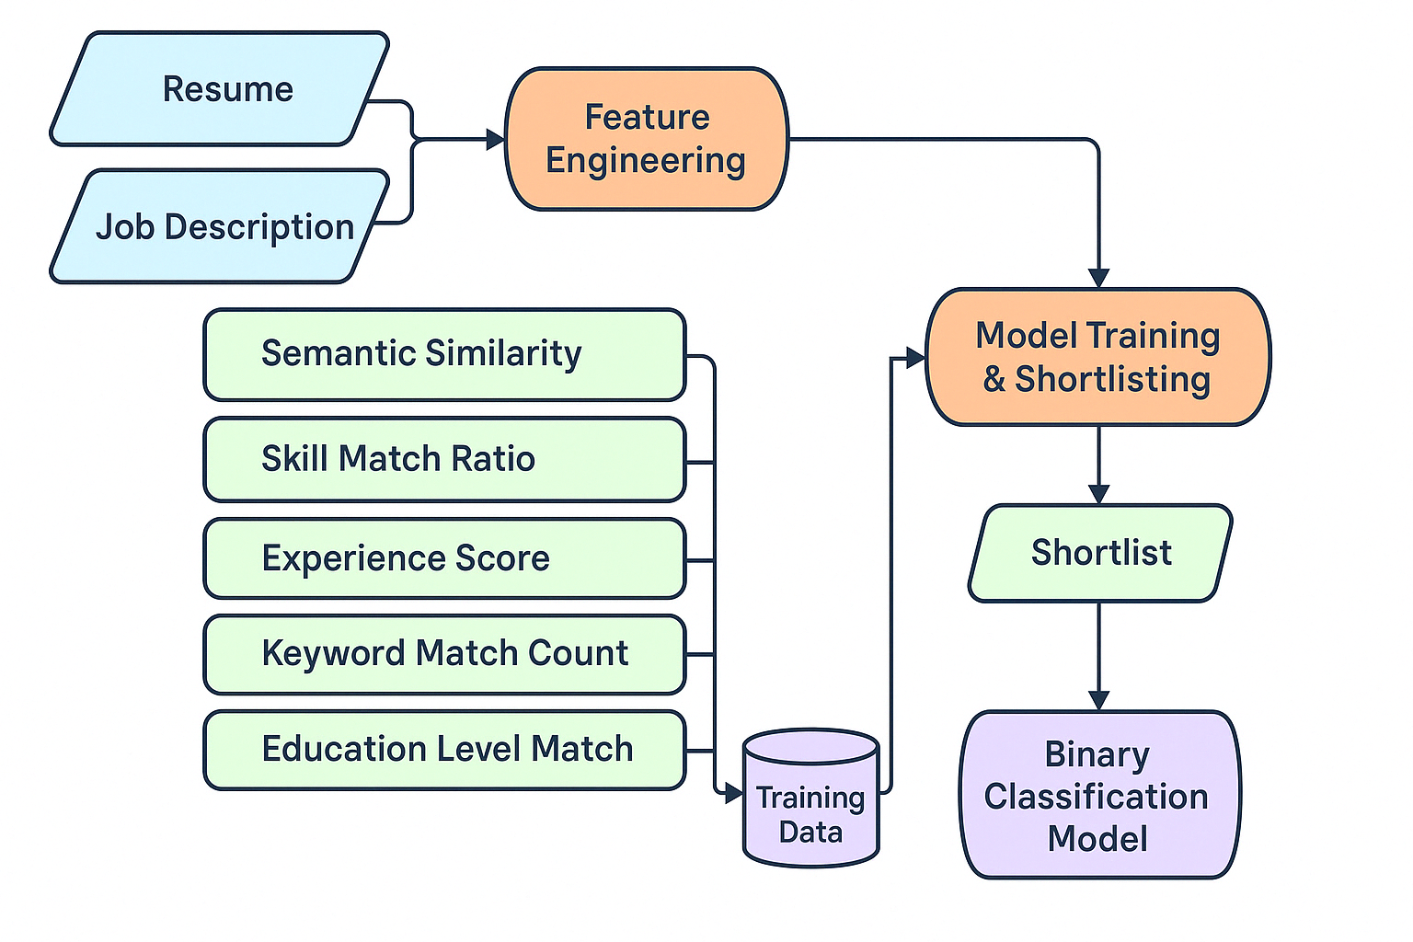
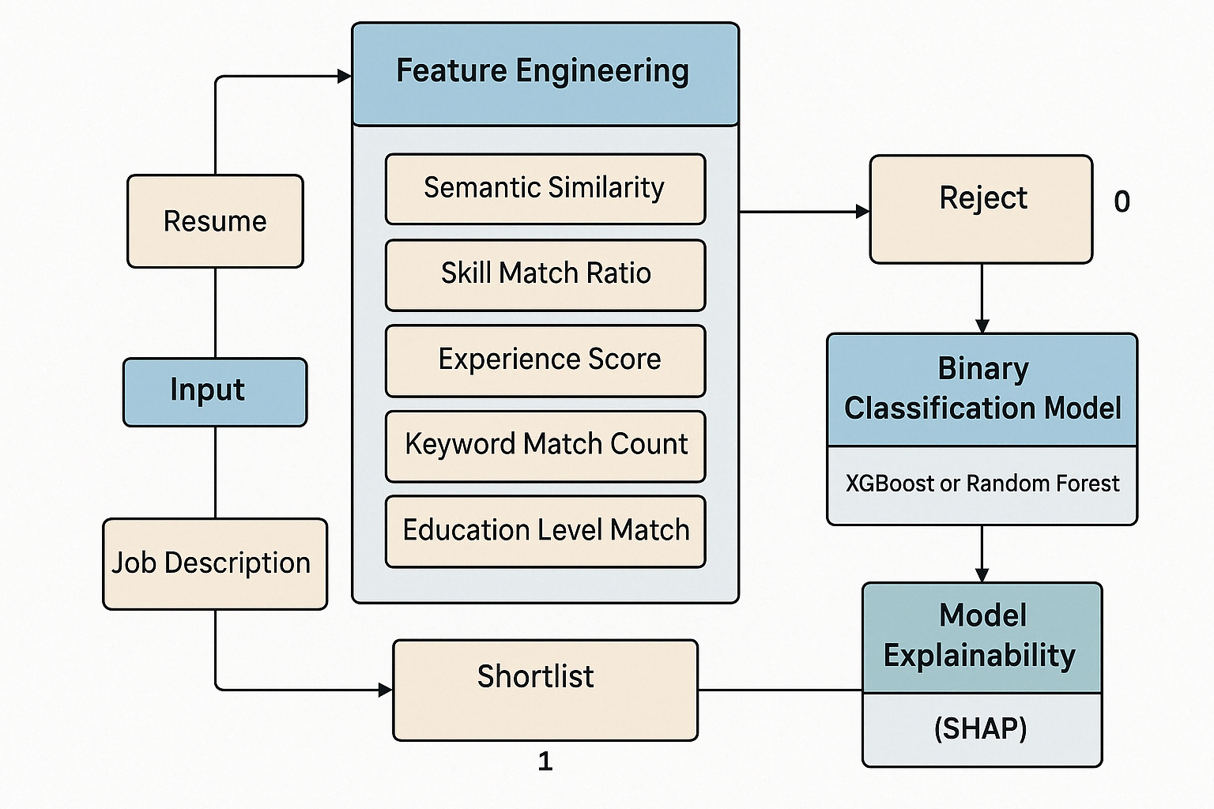
System Architecture

Slide 7
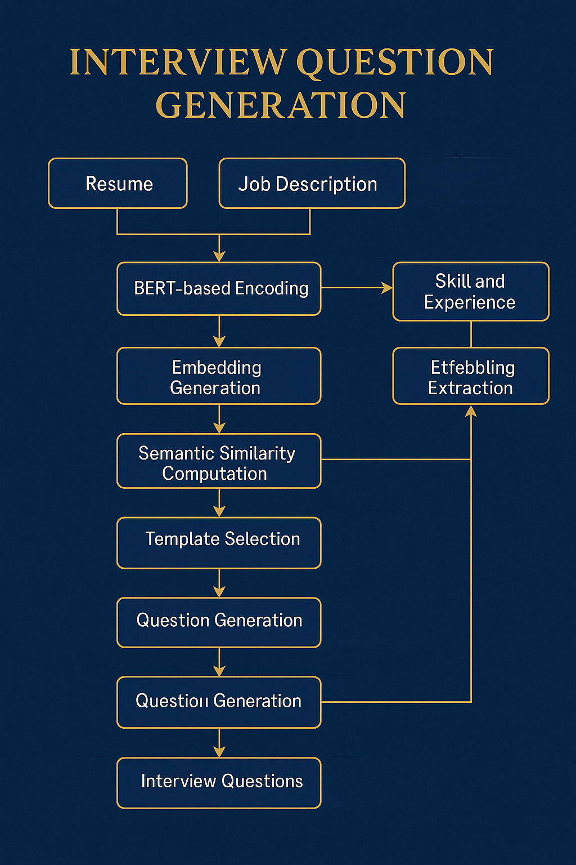
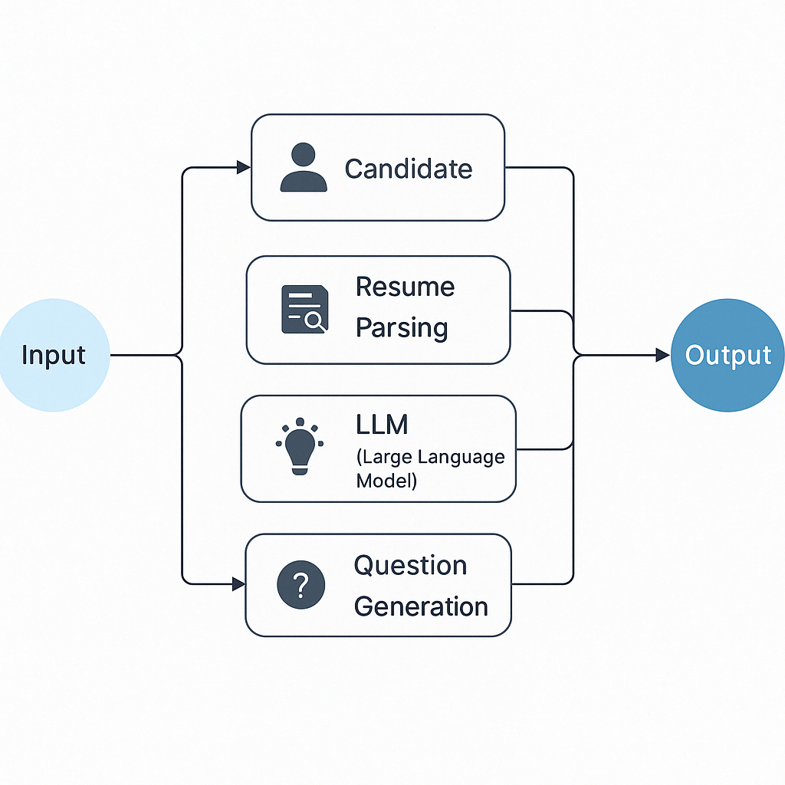

Slide 8
Dataset Details
Types of Data Used
Resumes: To extract skills, experience, education, and match relevance to job descriptions
Job Descriptions (JDs): To define the required qualifications, responsibilities, and skills
Labeled JD–Resume Pairs: For training the ML model to predict “Shortlist” vs “Reject”
Data Sources
Resumes: Kaggle Resume Dataset, OpenResumes GitHub and Custom-generated and synthetic resumes for specific roles
Job Descriptions (JDs): Manually collected from LinkedIn, Indeed, and Glassdoor, Used Kaggle Job Description Dataset for large-scale JDs
Shortlist Labels (1/0): Manually labeled based on skill overlap, semantic similarity, and experience match. Also generated synthetic labeling rules to augment small datasets

Slide 9
Data Preparation
Data Cleaning & Preprocessing
Preprocessing Applied
Cleaned PDF resumes using pdfplumber
Standardized resume and JD structure for fair processing
Engineered structured features (skill match, experience years, etc.)

Slide 10
Feature Engineering
What is Feature Engineering?
Feature engineering is the process of transforming cleaned, unstructured resume and JD data into structured numerical features that can be used to train our ML model.
It ensures the classifier understands how well a resume matches a job description in measurable terms.
Feature Name | Description
Semantic Similarity | Score from Sentence- BERT
Skill Match Ratio | Percentage of JD-required Skills
Experience Score | Score Based on total years of experience
Education Match | Binary (1/0)
Keyword Match Count | Count of relevant overlapping keywords
Certification Match | Check if certifications are required

Slide 11
How Features Will be Calculated
Text Embeddings: BERT converts resume and JD into 768-dimensional vectors
Skill Matching: Based on pre-defined skill dictionaries or NER models
Experience Parsing: Regex extracts date ranges → compute total experience
Education Normalization: Degree + university mapped against JD keyword
Output Format
Features are stored in a structured tabular format (like a DataFrame):
[ resume_id, semantic_similarity, skill_match_ratio, experience_score, education_match, ... ]

Slide 12
Model Training & Evaluation
Objective of Model Training
To train a machine learning classifier that can accurately predict whether a candidate should be shortlisted or rejected, based on multiple extracted features from the resume–JD pair.
Model Selection: XGBoost Classifier
We selected XGBoost (Extreme Gradient Boosting) due to:
High performance on structured/tabular data
Built-in handling of non-linear feature interactions
Robust to imbalanced datasets and missing values
Provides native support for feature importance analysis

Slide 13
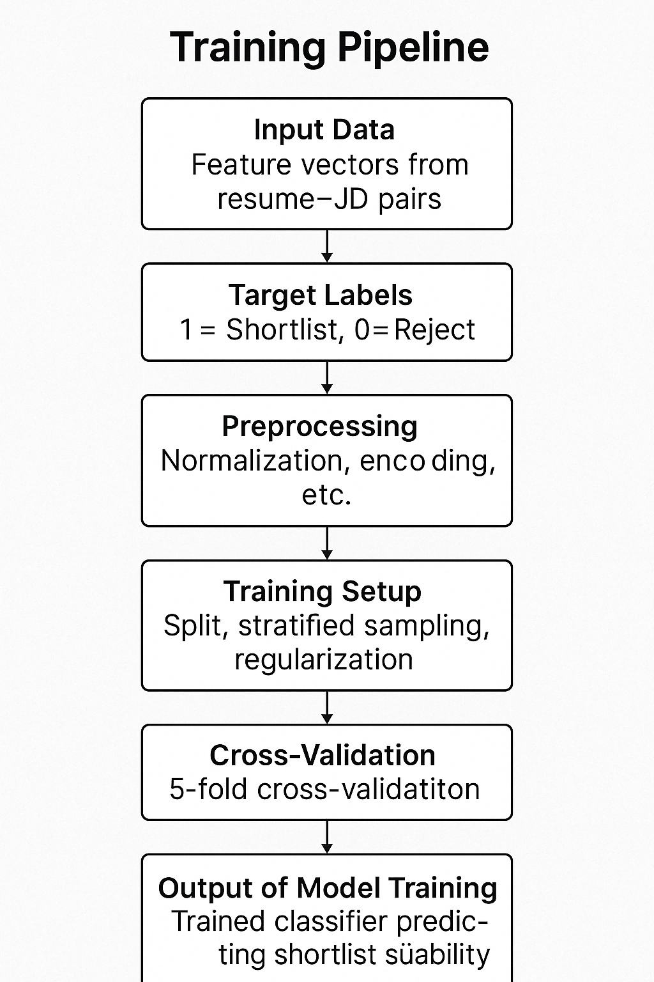
Training Pipeline Overview
Output of Model Training
A trained XGBoost binary classification model capable of:
Evaluating unseen resume–JD pairs
Predicting shortlist suitability in real-time
Providing feature-wise importance for explainability

Slide 14
Model Explainability with SHAP
Why Model Explainability Matters
In real-world applications — especially in hiring and HR tech — it's not enough for a model to just give a prediction.
We must answer:
“Why was this resume shortlisted?” “What features influenced the decision?”
That’s where SHAP comes in.
How We Used SHAP in Our Project
Applied SHAP on the trained XGBoost model
Generated explanation plots for each resume–JD prediction
Identified which features contributed most to a shortlist/reject decision

Slide 15
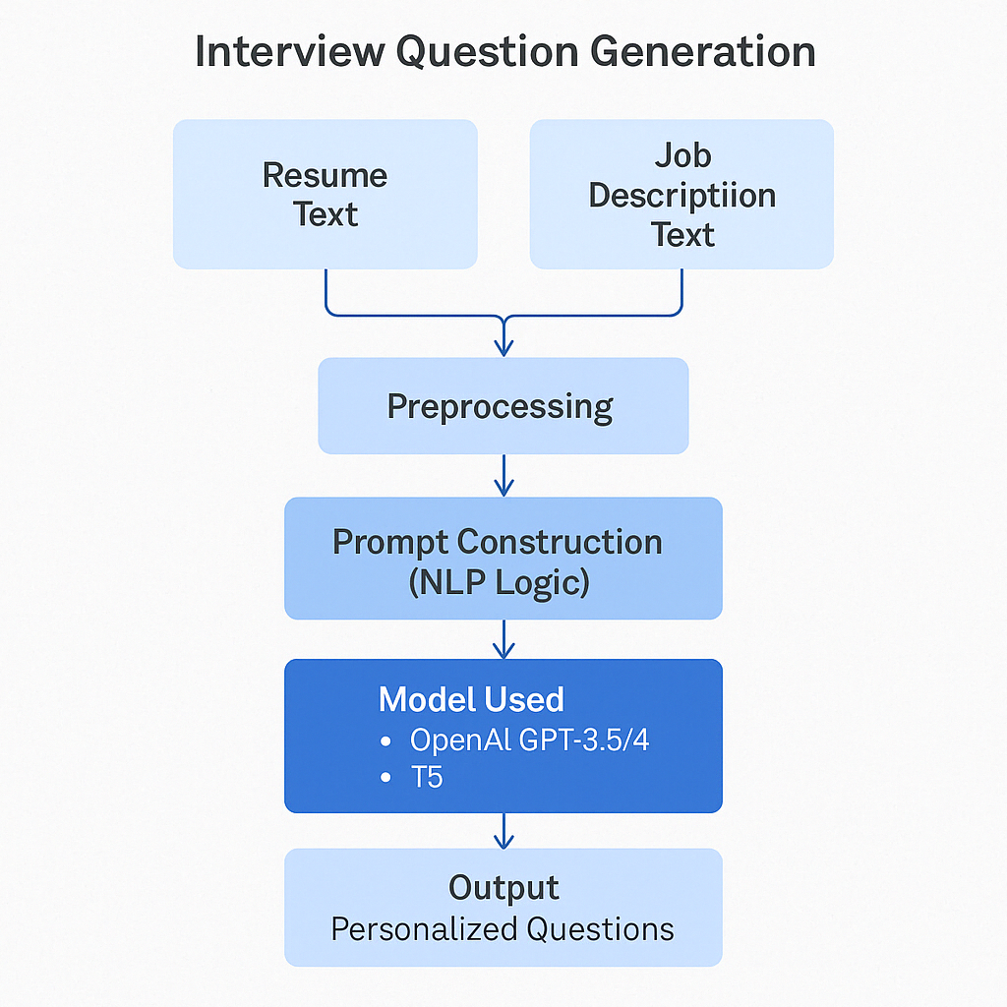
Interview Question Generation Module
Objective
To generate role-specific, context-aware interview questions based on:
The candidate’s resume content
The skills and requirements mentioned in the job description
This ensures that interviewers ask questions that are relevant, personalized, and meaningful.

Slide 16
What Our System Delivers
1. Intelligent Resume Ranking
Uses BERT-based semantic similarity + skill & experience analysis to rank resumes against a job description.
Output: Match Score (0–100)
Input: Resume + JD
Output: Ranked list of resumes by relevance
2. Automated Shortlisting Prediction
Trained XGBoost classifier evaluates whether a resume should be shortlisted.
Binary output: Shortlist (1) or Reject (0)
Based on features: skill match %, semantic match, experience, education
Fully explainable using SHAP analysis
3. Personalized Interview Question Generation
Uses OpenAI GPT-3.5/4 or T5 to generate context-aware questions tailored to each candidate.
Inputs: Extracted resume & JD keywords
Output: 5–10 smart, technical + behavioral questions
Makes interviews more targeted and efficient
4. Transparency via Explainability
SHAP visualizations explain why a resume was shortlisted or rejected.
Feature importance: Skill match, similarity, experience
Waterfall/force plots highlight reasoning

Slide 17
Project Progress – Mid Semester Status
Completed
Problem Identification & Motivation clearly defined
Dataset Collection from Kaggle, GitHub & custom sources
Resume & JD Preprocessing using PDF extraction and text cleaning
Feature Engineering (semantic similarity, skill match, experience score)
ML Model Training (XGBoost) for Shortlist Prediction
Initial SHAP Integration for model explainability
Interview Question Generation Prototype using GPT-based prompts
Remaining
UI Integration using Streamlit/Flask (under development)
End-to-End Pipeline Testing (resume upload → questions output)
Final SHAP Visualizations with real examples
Performance Metrics Visualization (if added)
Final Report Writing & Formatting

Slide 18
Challenges & Limitations
Unstructured Resume Formats
Limited Labeled Data for Shortlisting
Skill Extraction Complexity
GPT-based Question Generation Limitations

Slide 19

Future Enhancements
Technical Improvements:
Domain-adaptive fine-tuning of NLP models
Multi-language support for global recruitment
Integration with video interview platforms
Business Applications:
Candidate feedback generation
Career path recommendation
Internal mobility matching

Slide 20

Conclusion
Automated resume ranking with explainable results
Personalized yet standardized interview process
Significant time savings for recruitment teams
Data-driven decisions to improve hiring quality
Adaptable system for various industries and roles
“We are not just automating hiring — we are making it smarter, fairer, and faster.”

Slide 21


